Slide 1
Realtime Mobile Dashboards with Salesforce1, Knockout.js, and Streaming AP
Notes:
Intro slides

Slide 2
Speakers
Chris Bland
Matt Lacey
Notes:
Will fill this out more when we get the template from salesforce.
I'm assuming they will ask for headshot/twitter handle here

Slide 3

How fresh is your data?
How often have you heard this:
  My dashboard is wrong:
    I just closed a deal and its not showing up
    The report that I run shows a different number
    I updated the report and the dashboard hasn't changed
Stale data from not pressing refresh
Notes:
First slide: Identify and connect with the audience on common ground. If admins in the crowd, identify the common problem we are looking to solve.
Problem: Users complain that their dashbaords are out of date. The data is old due to them not pressing refresh, either by not knowing they need to or forgetting.

Slide 4
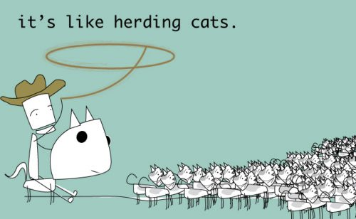
Solutions
Train ALL of your users to remember to press the refresh button on their dashboards every time
Notes:
Present a solution that is not feasible in order to get the audience to identify with our solution
Make cat joke, users are hard to train, they are unpredictable, there are always new ones. There is no way to solve this problem through training on any kind of scale.

Slide 5
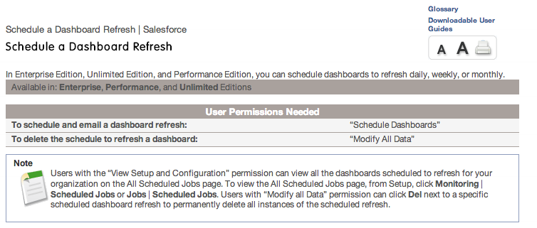
Solutions
Schedule a Dashboard Refresh
This is better... but your data is still only as up to date
as your last scheduled refresh
Notes:
Present the 2nd possible solution, a platform feature. This solves some of the problems, but has its limitations
Pros: Dashboards get automatically updated!
Cons: They are out of date as soon as they are updated.

Slide 6
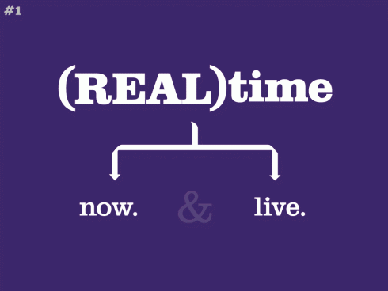
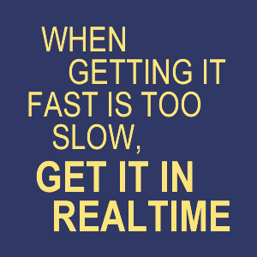
Solutions
Build a Real Time dashboard with Knockout.js and the Streaming API!
Notes:
W00t – A solution that solves both problems.
Our data will be up to date all of the time.

Slide 7


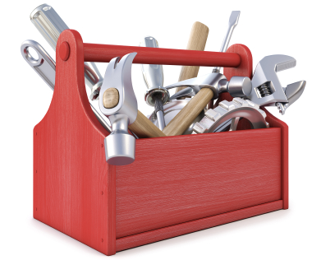


Our Tools
Streaming API & Push Topics
A scalable comet (server push) implementation for web messaging.
Dynamic JavaScript UIs with the Model-View-View Model (MVVM) pattern.
JavaScript library designed to simplify the client-side scripting of HTML

Slide 8
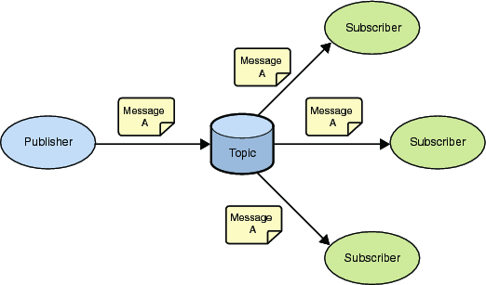
Streaming API
Publish / Subscribe model. (Pub/Sub)

Slide 9
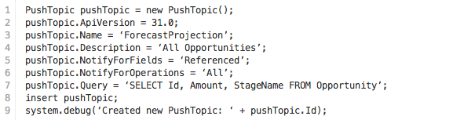
Creating a push topic
Lets create a dashboard to show us the total dollars in each stage:
We need to keep track of the following fields: Amount, StageName.
We will create a PushTopic to let us know about all events (Create, Update, Delete) related to all opportunities in our system.

Slide 10
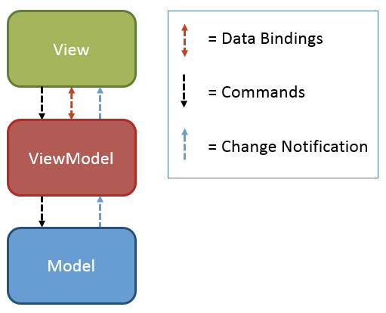
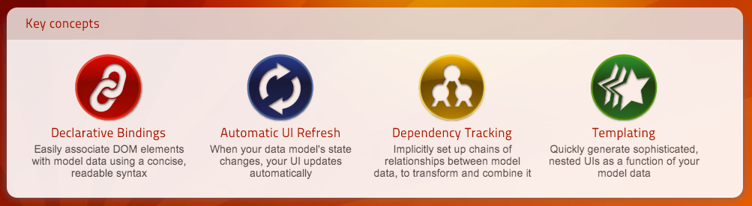
What is Knockout / MVVM?

Slide 11
Model
Domain-specific data
Holds information, not behavior
Does not handle any formatting of data

Slide 12
View
What the user interacts with:
  Structure
  Layout
  Appearance
Represents the “State” of the ViewModel
Contains our data-bindings that allow the magic of Knockout to work

Slide 13
ViewModel
Representation of data and operations that can be performed on a UI.
Similar to Controllers, it takes information from the Model and passes it to the View.
Passes commands and events from our View to our Model
Handles formatting
  Example: Our ViewModel knows the local time of the user and can present DateTimes in the current users time.

Slide 14
Lets Code
DEMO HERE

